Slide 1
Collections
Mr Giridharan.R M.E.,M.B.A.,
Assistant Professor, Dept of CSE,
Sri Eshwar College of Engineering,
Coimbatore - 641202

Slide 2
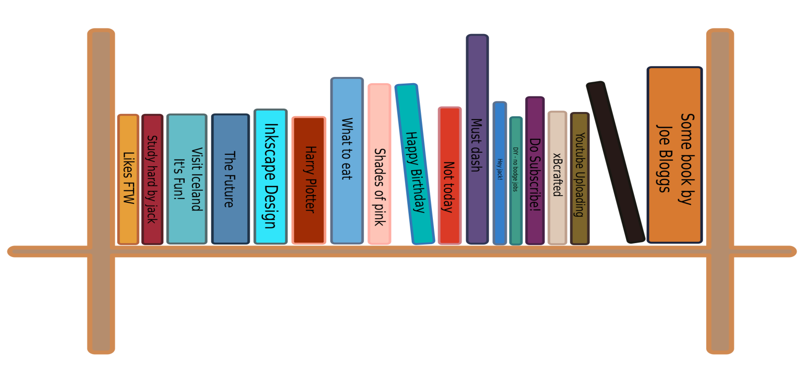
Introduction to Collections
A collection — sometimes called a container — is simply an object that groups multiple elements into a single unit.
Collections are used to store, retrieve, manipulate, and communicate aggregate data.

Slide 3
What Is a Collections Framework?
A collections framework is a unified architecture for representing and manipulating collections.
All collections frameworks contain the following:
Interfaces
Implementations
Algorithms
Benefits of the Java Collections Framework
Reduces programming effort
Increases program speed and quality
Allows interoperability among unrelated APIs
Reduces effort to learn and to use new APIs
Reduces effort to design new APIs
Fosters software reuse

Slide 4
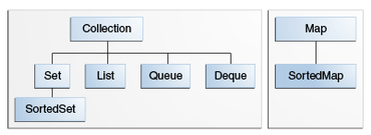
Interfaces
Collection
Set
List
Queue
Deque
Map
SortedSet
SortedMap

Slide 5
The Collection Interface
Basic operations
Bulk Operations
int size()
boolean isEmpty()
boolean contains(E)
boolean add(E)
boolean remove(E)
Iterator<E> iterator()
Array Operations
c.toArray()
c.toArray(new String[0])
boolean containsAll(Collection c)
boolean addAll(Collection c)
boolean removeAll(Collection c)
boolean retainAll(Collection c)
void clear()

Slide 6
Traversing Collections
There are three ways to traverse collections
Aggregate Operations
for-each Construct
Iterators
myShapesCollection.forEach(e -> System.out.println(e.getName()));
for (Object o : collection) System.out.println(o);
for (Iterator it = c.iterator();it.hasNext(); )
if (!cond(it.next()))
it.remove();

Slide 7
The Set Interface
A Set is a Collection that cannot contain duplicate elements.
The Set interface contains only methods inherited from Collection and adds the restriction that duplicate elements are prohibited.
Set also adds a stronger contract on the behavior of the equals and hashCode operations
Two Set instances are equal if they contain the same elements.

Slide 8
The Set Interface
Iterable
Interface
Collection
Class
Set
HashSet
LinkedHashSet
SortedSet
TreeSet

Slide 9
The Set Interface
The Java platform contains three general-purpose Set implementations:
HashSet -> hash table -> no order.
LinkedHashSet -> hash table with a linked list -> insertion-order.
TreeSet ->red-black tree, ->orders based on their values.

Slide 10
Set Interface Operations
Basic Operations
Bulk Operations
boolean add(E e)
boolean contains(Object o)
boolean equals(Object o)
int hashCode()
Iterator<E> iterator()
boolean remove(Object o)
int size()
boolean isEmpty()
boolean addAll(Collection c)
void clear()
boolean containsAll(Collection c)
boolean removeAll(Collection c)
boolean retainAll(Collection c)
Object[] toArray()
<T> T[] toArray(T[] a)

Slide 11
Set Basic Operations
Create a Set
Set<Integer> number = new HashSet<Integer>();
Set<String> name = new LinkedHashSet<String>();
Adding Elements to a set
number.add(5)
number.add(10)
name.add(“Arun”)
name.add(“Babu”)
Remove a element
name.remove(Arun”)
Iterating a set
for(String s:name) { System.out.println(s) }

Slide 12
The Queue Interface
A Queue is a collection for holding elements prior to processing.
Queues typically, but not necessarily, order elements in a FIFO.
Besides basic Collection operations, queues provide additional insertion, removal, and inspection operations.
Such as
offer(e)
poll()
peek()
element()
Each Queue method exists in two forms:
(1) one throws an exception if the operation fails
(2) the other returns a special value if the operation fails

Slide 13
Queue Interface Structure
Type of Operation | Throws exception | Returns special value
Insert | add(e) | offer(e)
Remove | remove() | poll()
Examine | element() | peek()

Slide 14
Queue Operations
The offer method inserts an element if possible, otherwise returning false.
The remove() and poll() methods remove and return the head of the queue.
The element() and peek() methods return, but do not remove, the head of the queue.

Slide 15
The Deque Interface
Usually pronounced as deck, a deque is a double-ended-queue.
A double-ended-queue is a linear collection of elements that supports the insertion and removal of elements at both end points.
The Deque interface is a richer abstract data type than both Stack and Queue because it implements both stacks and queues at the same time.
Predefined classes like ArrayDeque and LinkedList implement the Deque interface.

Slide 16
Deque Methods
Type of Operation | First Element (Head) |  | Last Element (Tail)
 | Throws exception | Special value | Throws exception | Special value
Insert | addFirst(e) | offerFirst(e) | addLast(e) | offerLast(e)
Remove | removeFirst() | pollFirst() | removeLast() | pollLast()
Examine | getFirst() | peekFirst() | getLast() | peekLast()

Slide 17
Comparison of Queue and Deque methods
Queue Method | Equivalent Deque Method
add(e) | addLast(e)
offer(e) | offerLast(e)
remove() | removeFirst()
poll() | pollFirst()
element() | getFirst()
peek() | peekFirst()

Slide 18
The Deque Interface
Deques can also be used as LIFO (Last-In-First-Out) stacks.
This interface should be used in preference to the legacy Stack class
When a deque is used as a stack, elements are pushed and popped from the beginning of the deque.
Comparison of Stack and Deque methods
Stack Method | Equivalent Deque Method
push(e) | addFirst(e)
pop() | removeFirst()
peek() | peekFirst()

Slide 19
The Map Interface
A Map is an object that maps keys to values.
A map cannot contain duplicate keys: Each key can map to at most one value.
The Java platform contains three general-purpose Map implementations:
HashMap -> No Ordering
LinkedHashMap -> Insertion Order
TreeMap -> Sorted Order
Their behavior and performance are precisely analogous to HashSet, TreeSet, and LinkedHashSet

Slide 20
The Map Interface
Interface
Map
Class
SortedMap
HashMap
TreeMap
LinkedHashMap

Slide 21
The Map Interface
Basic operations
Bulk Operations
int size()
boolean isEmpty()
boolean containsKey(Object key)
boolean containsValue(Object value)
V put(K key, V value)
V get(Object key)
V remove(Object key)
default void replaceAll(BiFunction<? super K,? super V,? extends V> function)
void putAll(Map<? extends K,? extends V> m)
void clear()

Slide 22
Collection Views
The Collection view methods allow a Map to be viewed as a Collection in these three ways:
keySet — the Set of keys contained in the Map
values — The Collection of values contained in the Map.
entrySet — the Set of key-value pairs contained in the Map.

Slide 23
Implementations
General-purpose implementations
Special-purpose implementations are designed for use in special situations
Concurrent implementations are designed to support high concurrency
Wrapper implementations
Convenience implementations are mini-implementations
Abstract implementations are skeletal implementations
The legacy collections Vector and Hashtable are synchronized.

Slide 24
General-purpose Implementations
Interfaces | Hash table | Resizable array | Tree | Linked list | Hash table + Linked list
Set | HashSet |  | TreeSet |  | LinkedHashSet
List |  | ArrayList |  | LinkedList
Queue
Deque |  | ArrayDeque |  | LinkedList
Map | HashMap |  | TreeMap |  | LinkedHashMap

Slide 25
Algorithms
This section briefly describes the following algorithms:
Sorting – Fast & Stable
Shuffling – Opposite to Sorting
Routine Data Manipulation – Reversr, Fill, Copy , Swap, addAll.
Searching - binarySearch
Composition - frequency , disjoint .
Finding Extreme Values - min , max

Slide 26
Questions and Exercises
What interface represents a collection that does not allow duplicate elements?
What interface forms the root of the collections hierarchy?
What interface represents a collection that holds elements prior to processing?
What interface represents a double-ended queue?
Name three different ways to iterate over the elements of a Collection

Slide 27


